Slide 1

Parameter selection | komm hol das lasso raus
Julius Welzel
Kiel, 12th December 2019

Slide 2
Comon
| missing data
COKI | Visit | Age | FESI | UPDRS | Step length | DIA-S | MoCA | Stroop | DTC_{mm}
COKI101 | T1 | 76
COKI102 | T1 | 88
COKI103 | T1 | 68
COKI103 | T3 | 69
.
.
.
.
.
.
COKI201 |  | 74
COKI202 |  | 97

Slide 3



How to statistic?
UPDRS
FESI
DTC_{mm}
TMT B
…
N = 361
N = 24

Slide 4


“In praise of linear models!”
Interpretability
Good predictive performance
Overfitting
Three classes
Subset selection
Shrinkage
Dimension reduction

Slide 5
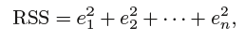
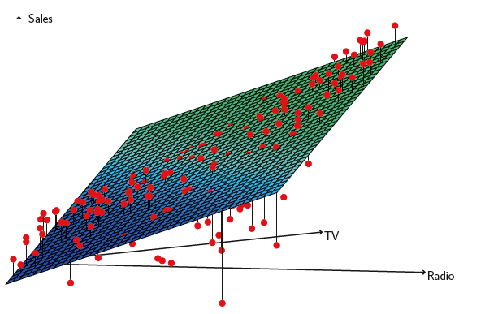
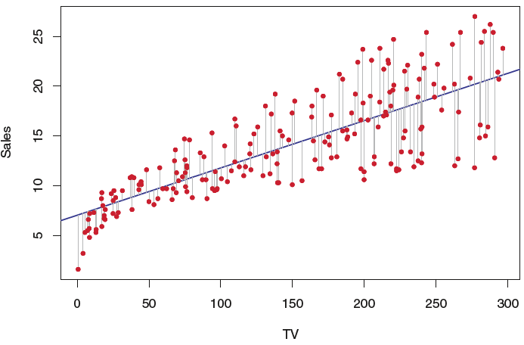
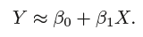

Good old simple linear regression

Slide 6
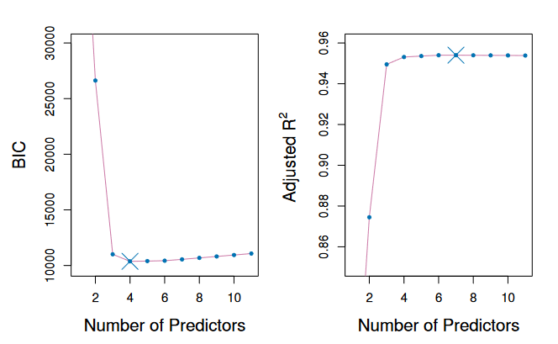
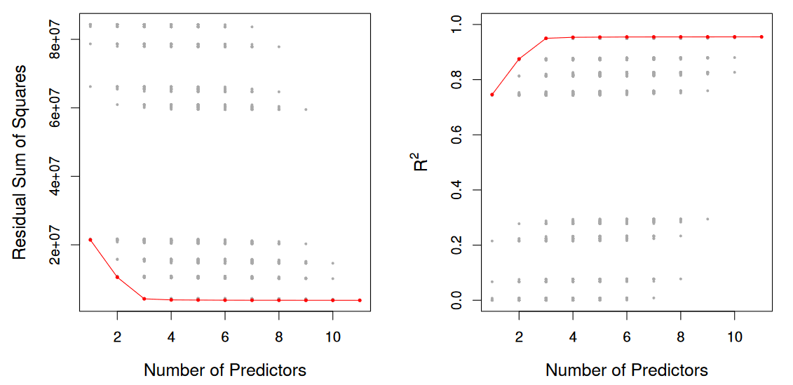
Subset selection
Stepwise selection
Select model M₀,..,M_{k} using
AIC/ BIC
_{adjusted}R2
Overfitting

Slide 7
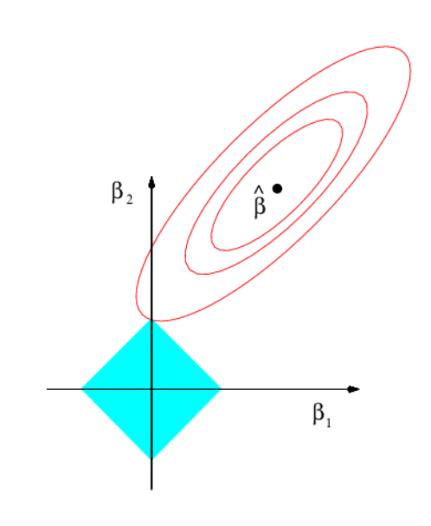
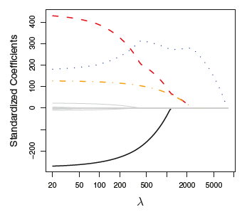
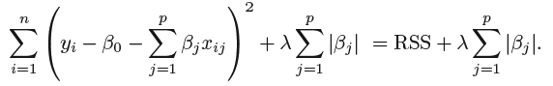
Shrinkage
| regularization
forcing some of the coefficient estimates to be exactly equal to zero

Slide 8
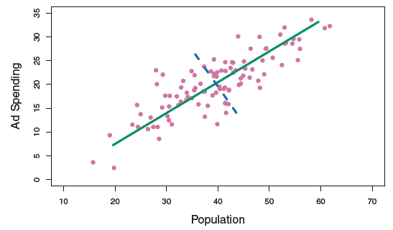
Dimension reduction
PCA (Hanna)
→Linear combination of parameters

Slide 9
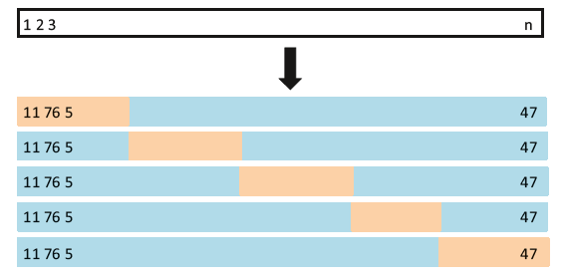
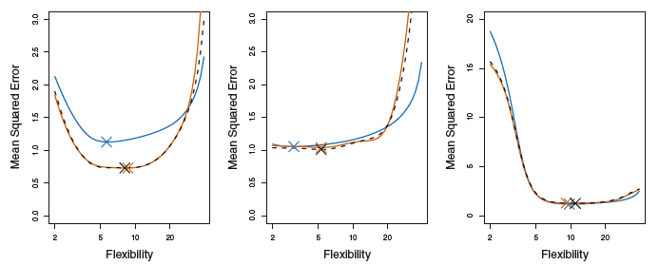
Cross validation

Slide 10
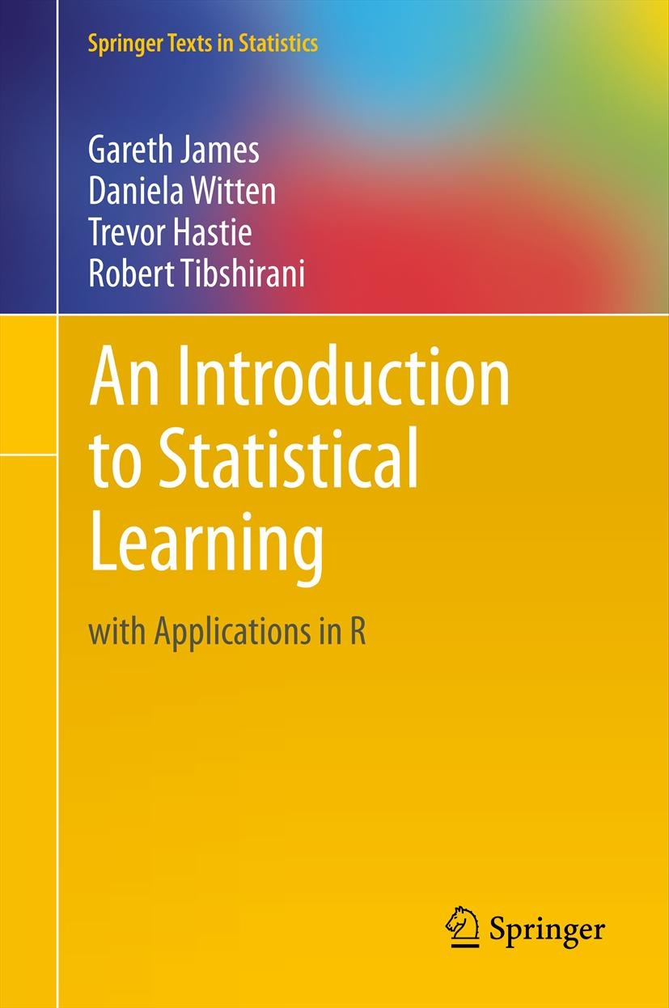
sources
Open access (5967 citations)
Additional slides & videos
R-code
Book: SAMBA
Rest: http://fs2.american.edu/alberto/www/analytics/ISLRLectures.html

Slide 11
Stats in the field | komm hol das lasso raus
Julius Welzel
Kiel, 7th January 2020

Slide 12
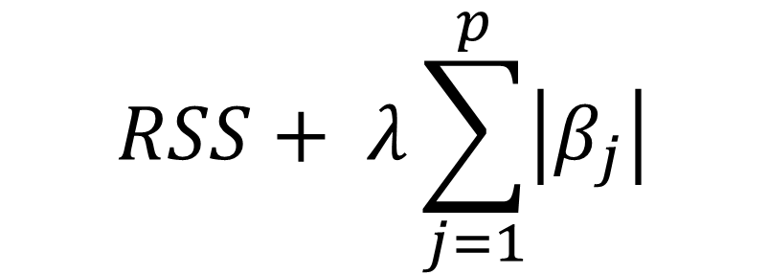
Shrinkage
| regularization
ICF model & ComOn
$$RSS+ λ\sum_{j=1}^{p}{\left|β_{j}\right|}$$
updrs_3_total_c
numberICDs
dia_s_total_score
bia_muscle_mass
FESI_total_score
aesd_s_total_score
moca_total
idal_total_score
adl_total_score
living_cond
sppb_total
NAA_total_score
age
gender
education
sppb_walking_aid
ΔTMT_{b-a}

Slide 13

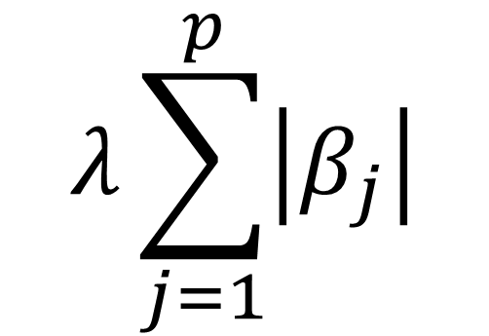
Cv and lasso
$$λ\sum_{j=1}^{p}{\left|β_{j}\right|}$$
CV (holdout: 25)
Training
Test
Training
Test
CV (holdout: 5)
Training
Test
Shrink 16 Variables?
Training
Test

Slide 14
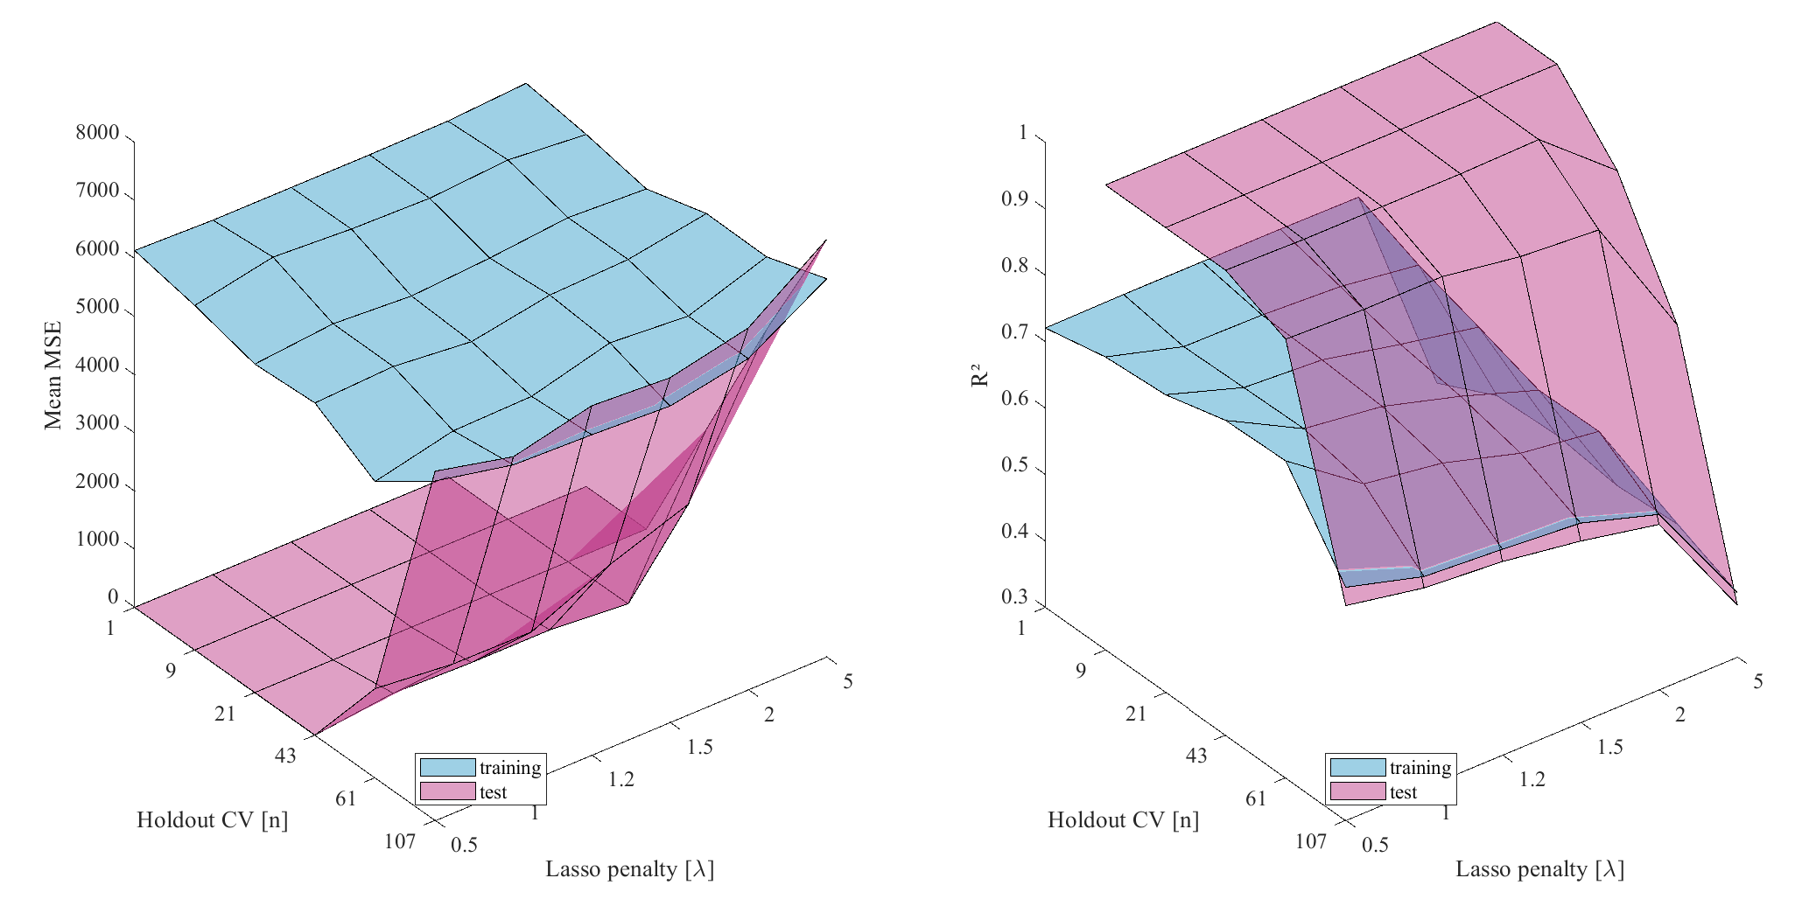
Lasso compare
| CV & lambda

Slide 15
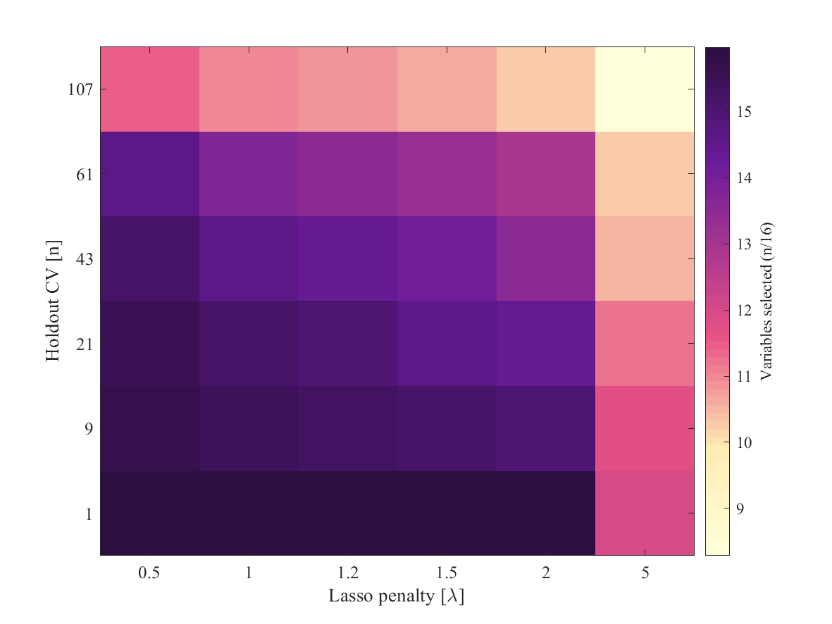
Lasso compare
| n of variables

Slide 16
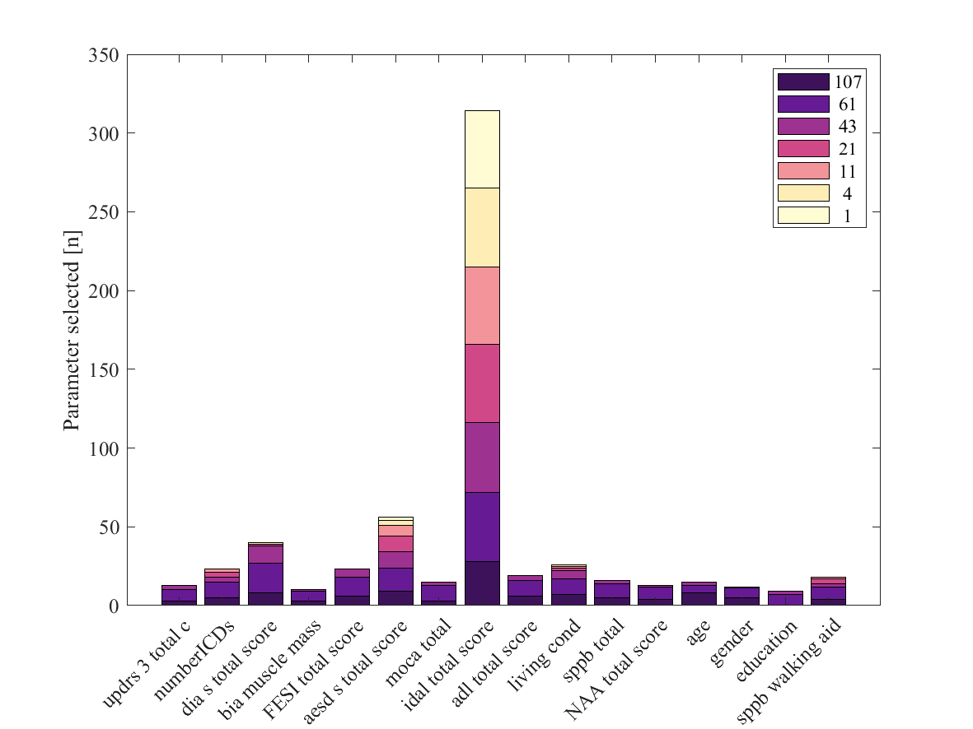
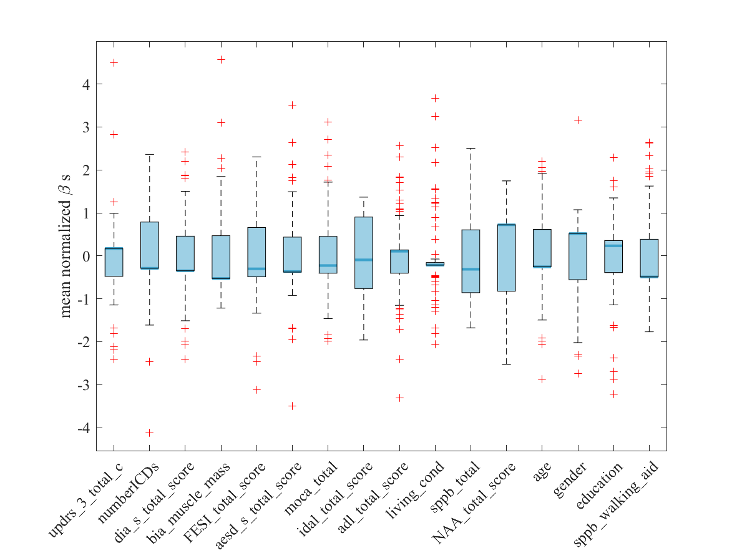
Lasso compare
| n of variables

Slide 17
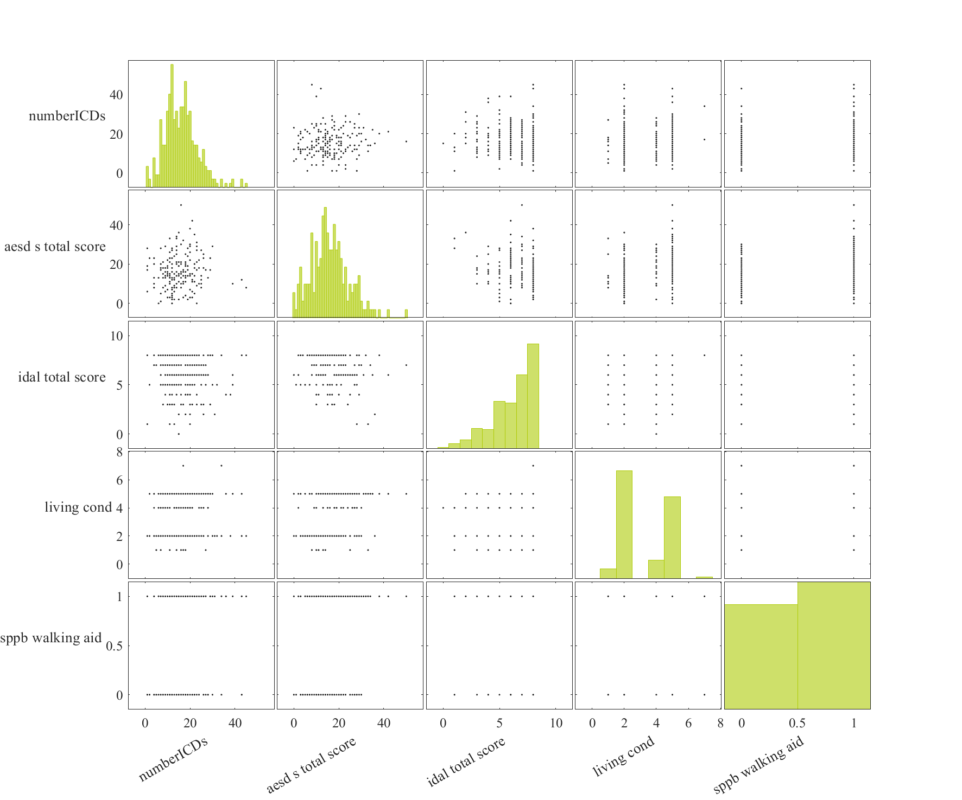
results
ordR | adjR | NumObs | F | p
0.1377 | 0.0838 | 86 | 2.5553 | 0.0338
Row | Estimate | SE | tStat | pValue
(Intercept) | 103.089 | 58.274 | 1.769 | 0.081
numberICDs | 0.804 | 1.396 | 0.576 | 0.566
aesd_s_total_score | 2.046 | 1.067 | 1.916 | 0.059
idal_total_score | -18.221 | 6.972 | -2.613 | 0.011
living_cond | 4.613 | 6.322 | 0.730 | 0.468
sppb_walking_aid | -35.835 | 20.075 | -1.785 | 0.078

Slide 18
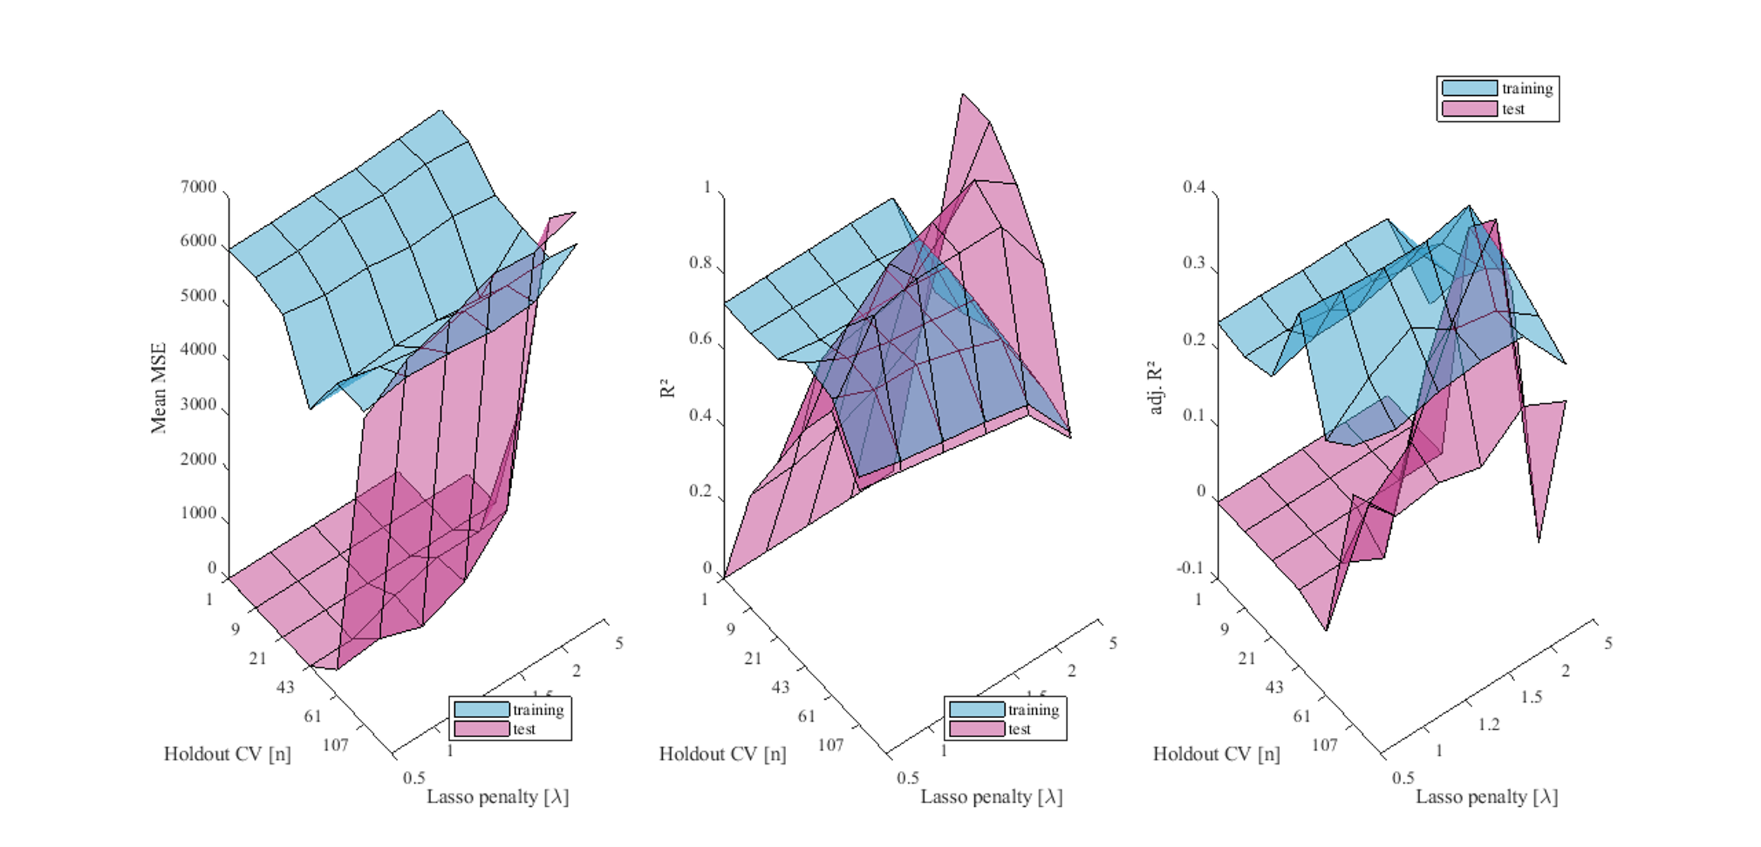
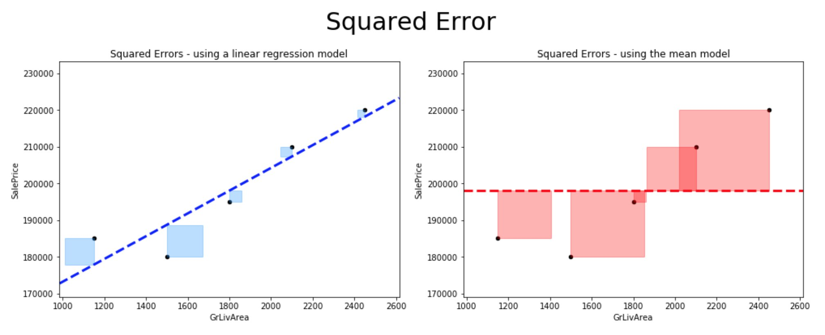
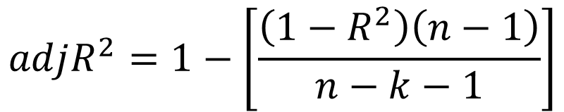
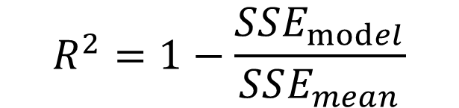
How to judge?
Mean MSE
R²
Adj R²
$$R^{2}=1−\frac{SSE_{model}}{SSE_{mean}}$$
$$adjR^{2}=1−\left[\frac{\left(1−R^{2}\right)\left(n−1\right)}{n−k−1}\right]$$

